Slide 1
Javascript vs. Java

Slide 2
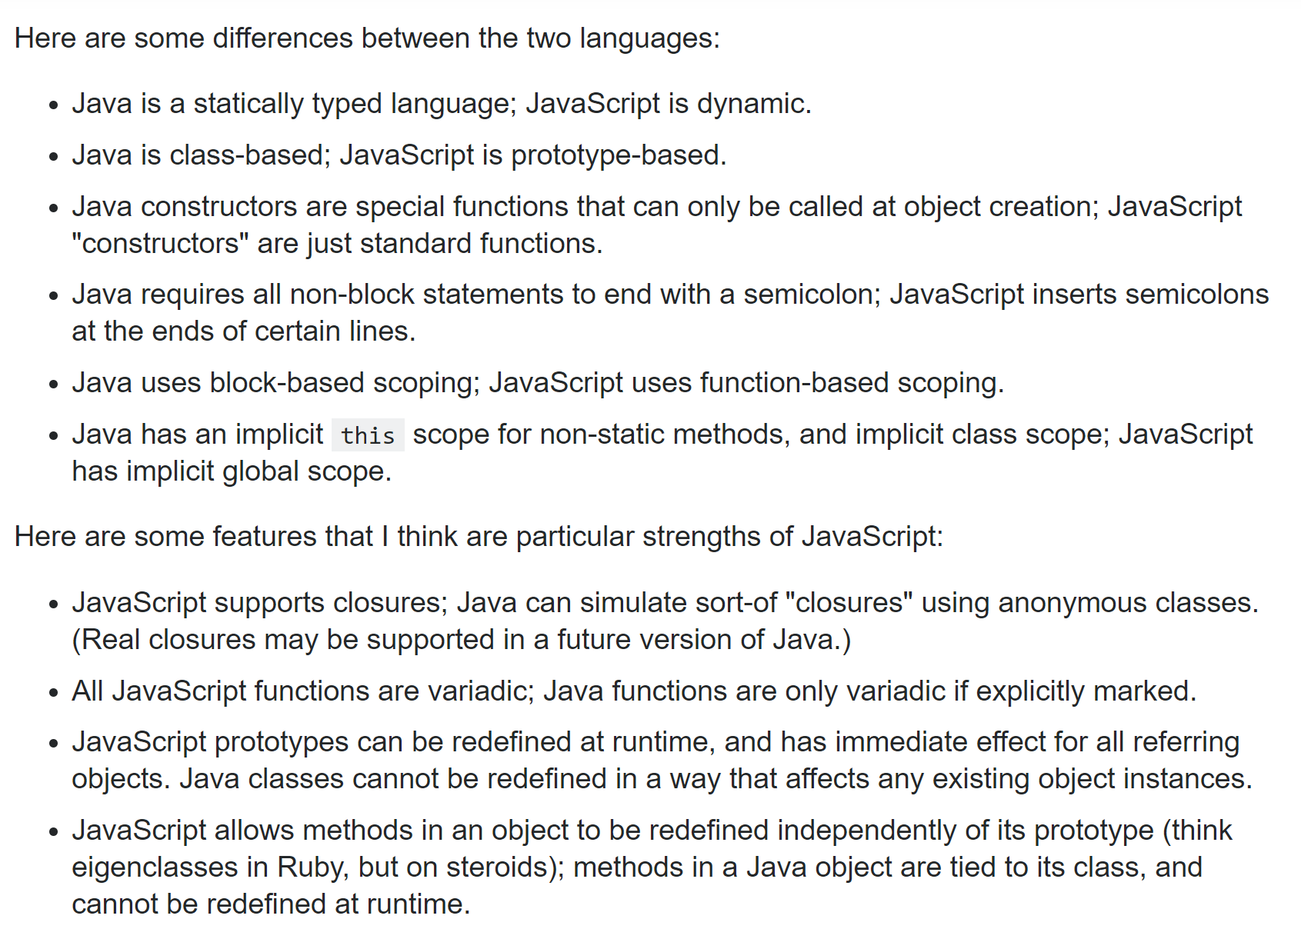
This is a thoughtful post…
https://stackoverflow.com/questions/245062/whats-the-difference-between-javascript-and-java
I would add: Java supports multi-threaded access to mutable data structures shared in memory;
In javascript, everything is multi-threaded except your code which runs single-threaded.
In Java GUIs, blocking code can be run in a background thread with callbacks to the GUI (AWT thread);
In browswer-based javascript, there is only the GUI thread and blocking functions are usually run on the server
(with a callback function to the single-threaded javascript code)

Slide 3
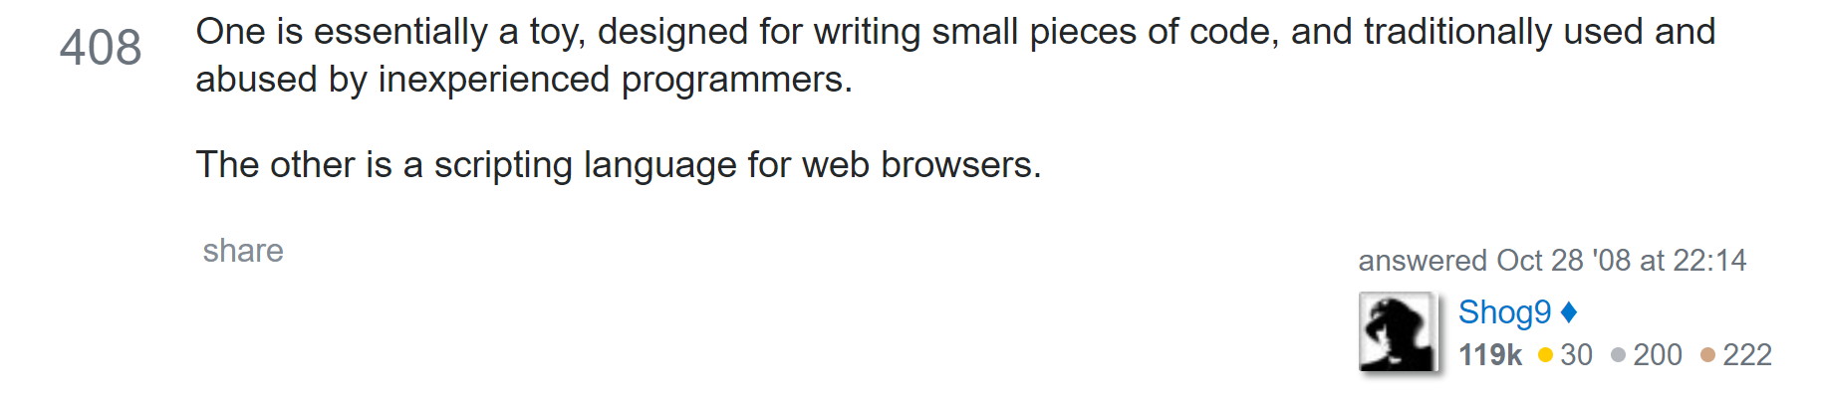
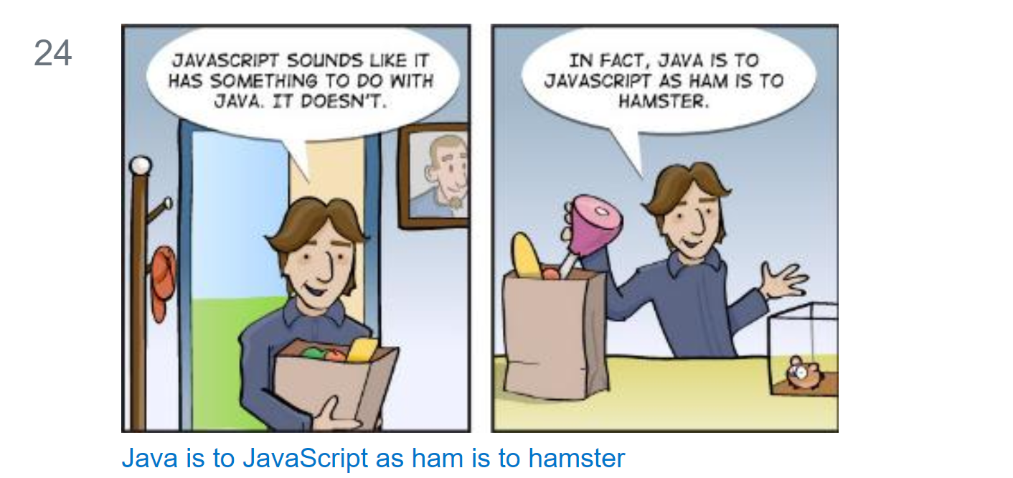
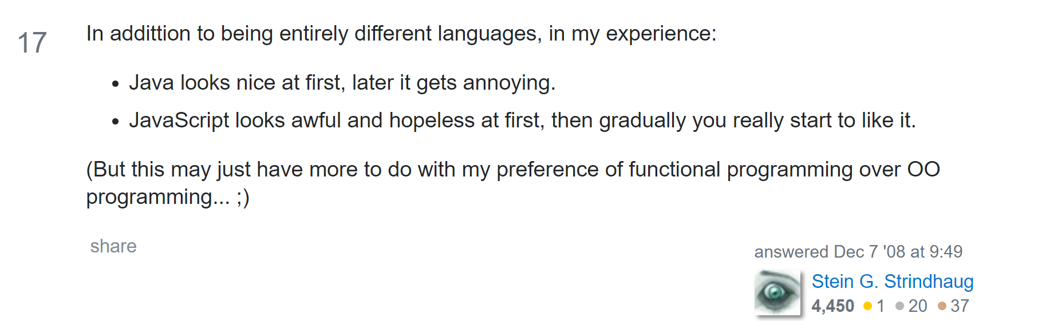
https://stackoverflow.com/questions/245062/whats-the-difference-between-javascript-and-java
There are also jokes, digs and things to think about…

Slide 4
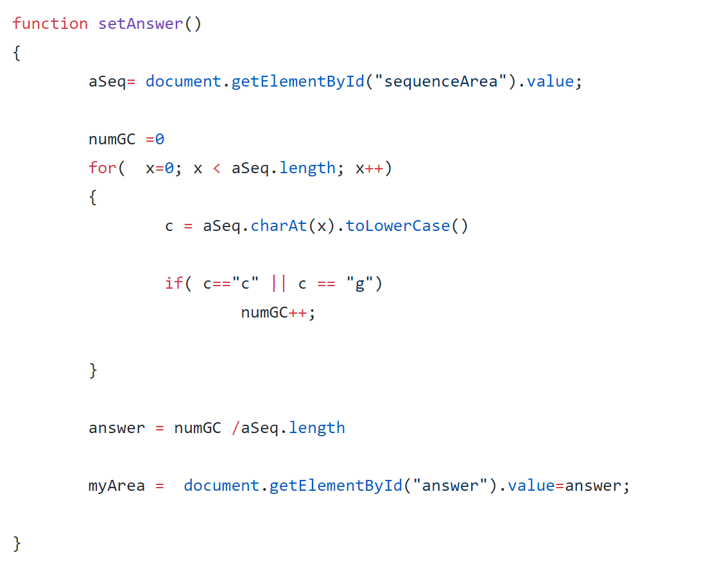
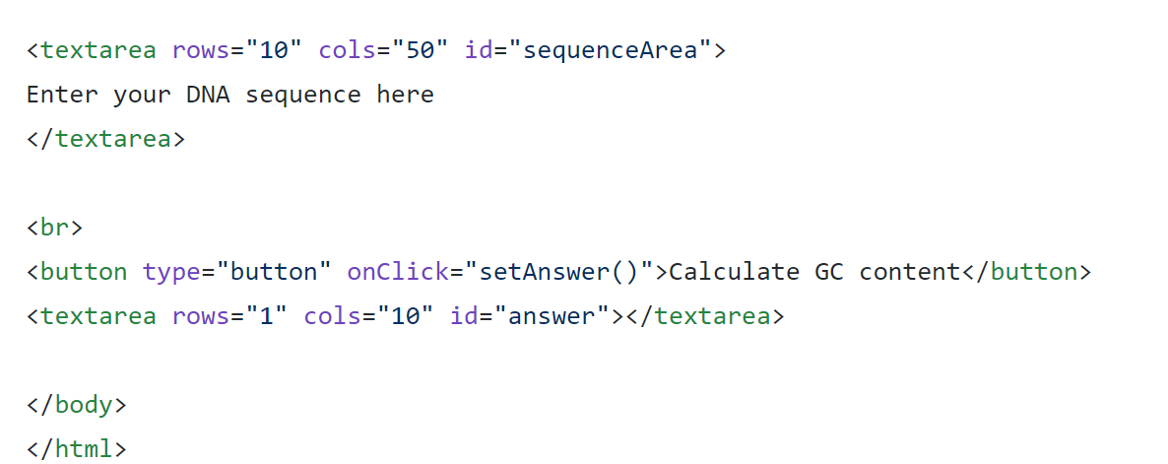
We’ve already seen javascript in the browser..
https://github.com/afodor/afodor.github.io/blob/master/exampleInput.html

Slide 5
Callbacks into the javascript thread work very similarly to callbacks to the AWT thread in Java
Javascript thread
User
Clicks on button
javascript does a bunch of things
Callback function() gets called when
javascript gets around to it
javascript does a bunch of other things
If you do something slow on the javascript thread you will crash the browser.
(Which is an unfriendly thing to your user)

Slide 6
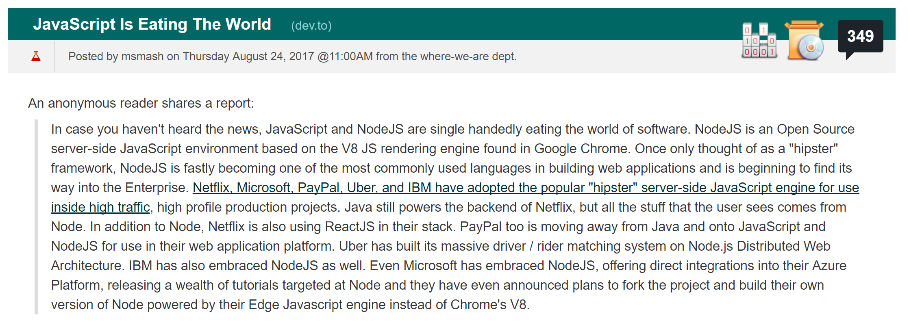
Surprisingly, javascript is gaining traction on the server using node.js.
node.js allows us to run javascript from the command line, which is useful when learning the language…
https://developers.slashdot.org/story/17/08/24/1457245/javascript-is-eating-the-world

Slide 7
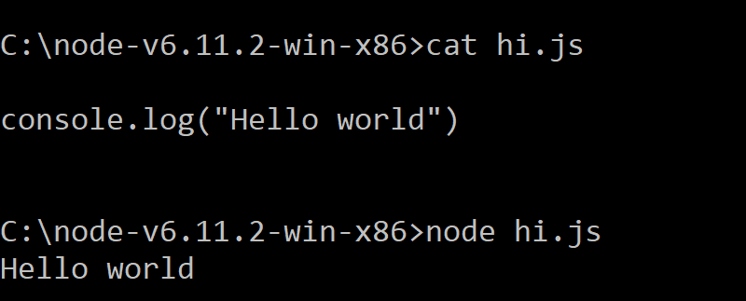
After installing node.js (on the platform of your choice) you will have a “node” executable…

Slide 8
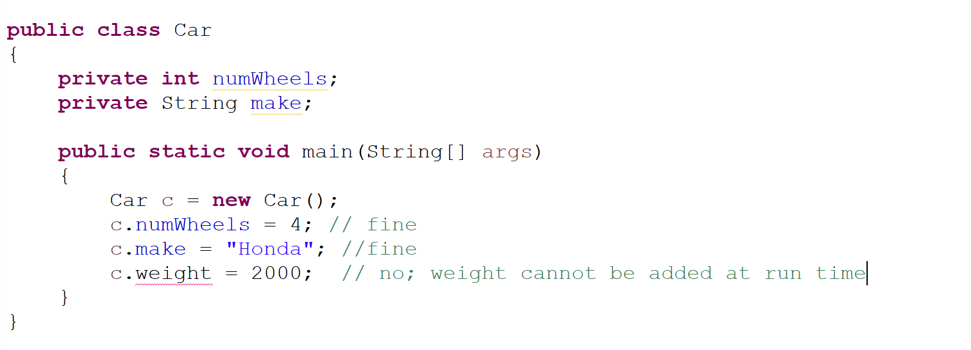
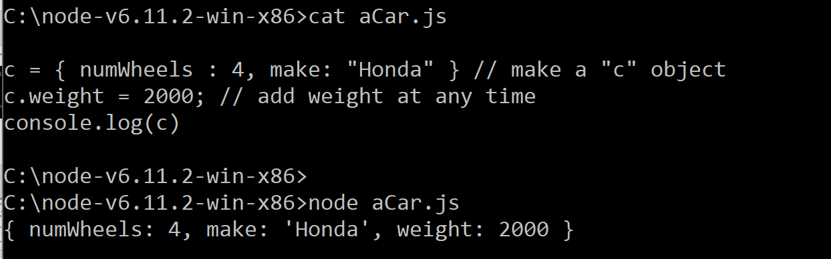
Java is a statically typed language; JavaScript is dynamic.
In Java, classes are defined at run time; you can’t add
features at run time
In javascript, there are no classes.
Everything is an object.
You can always add features to your object.
Objects in javascript are sort of like hash maps or
dictionaries ;
Just a collection of keys and values…
Objects in Java are instances of strongly-typed classes
(whose contents are defined at compile time but
instantiated at run-time)

Slide 9
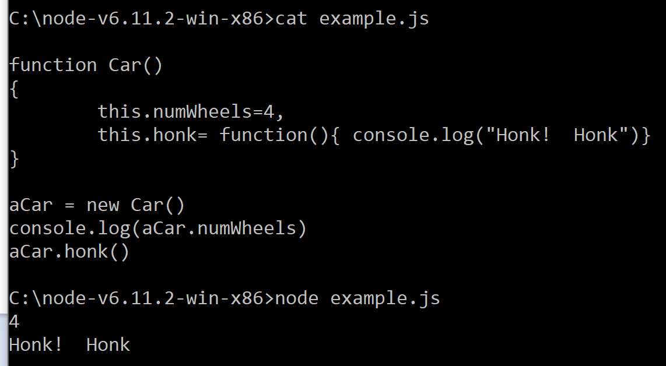
In Javascript, functions are “first-class” objects.
They can have parameters and references to other functions (and can, of course, be invoked).
In Java, functions are just functions

Slide 10
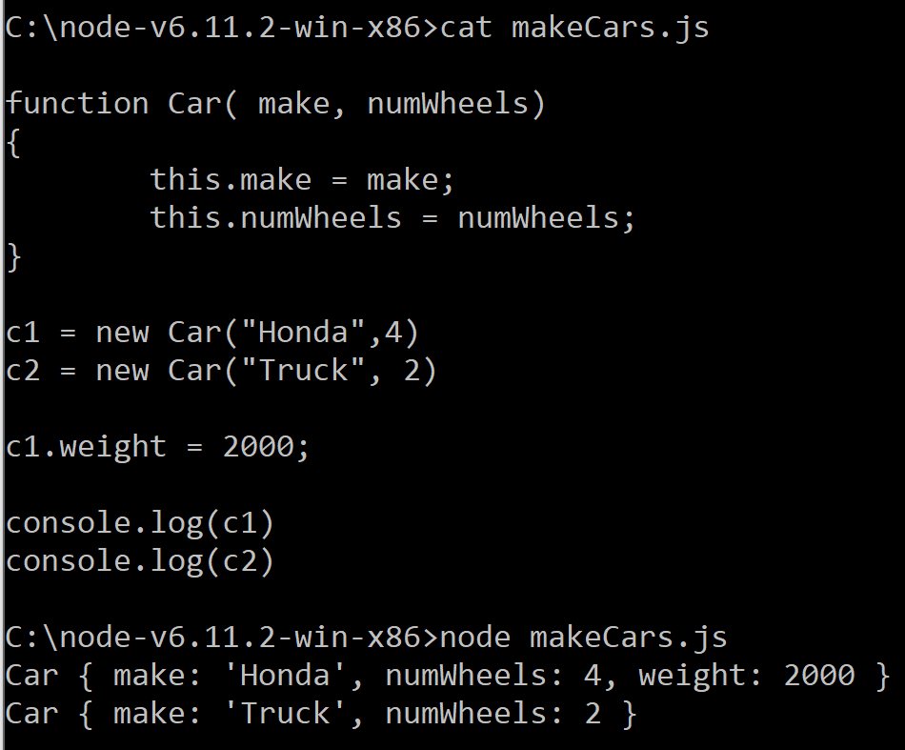
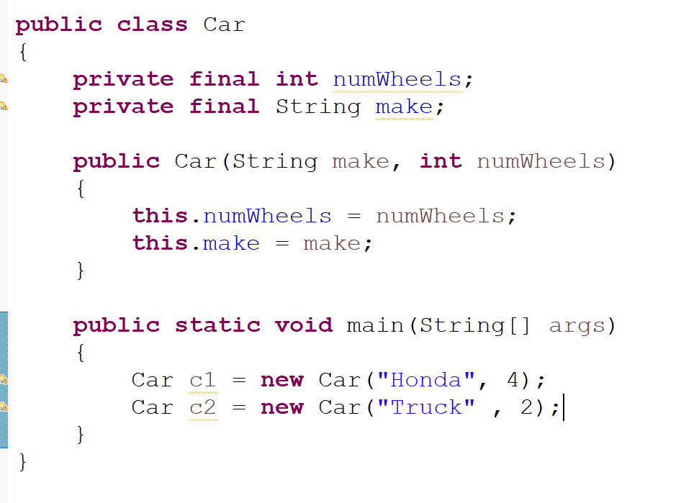
Java constructors are special functions that can only be called at object creation; JavaScript "constructors" are just standard functions.

Slide 11
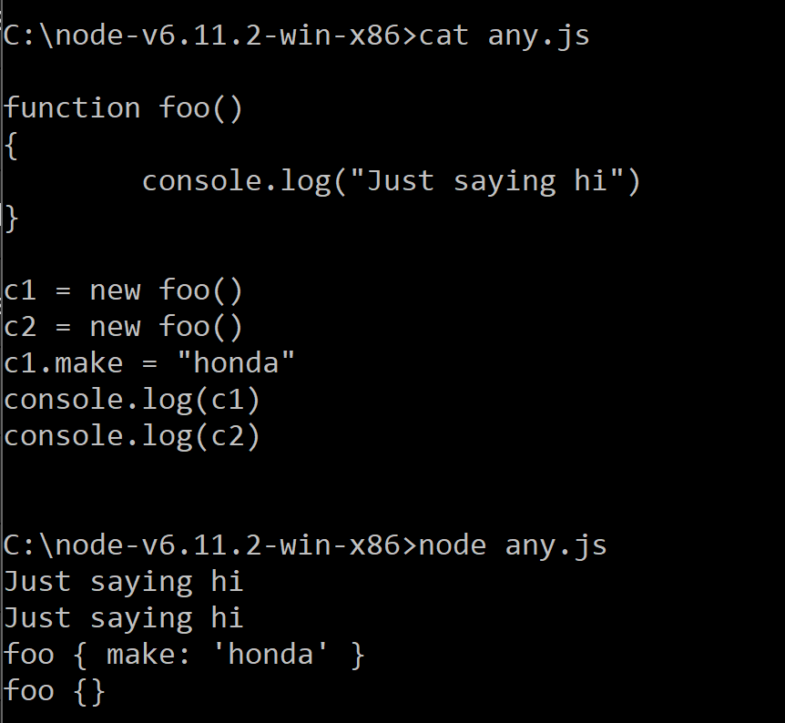
In Javascript, any function can be a constructor (but by style convention, they start with capitol letters)

Slide 12
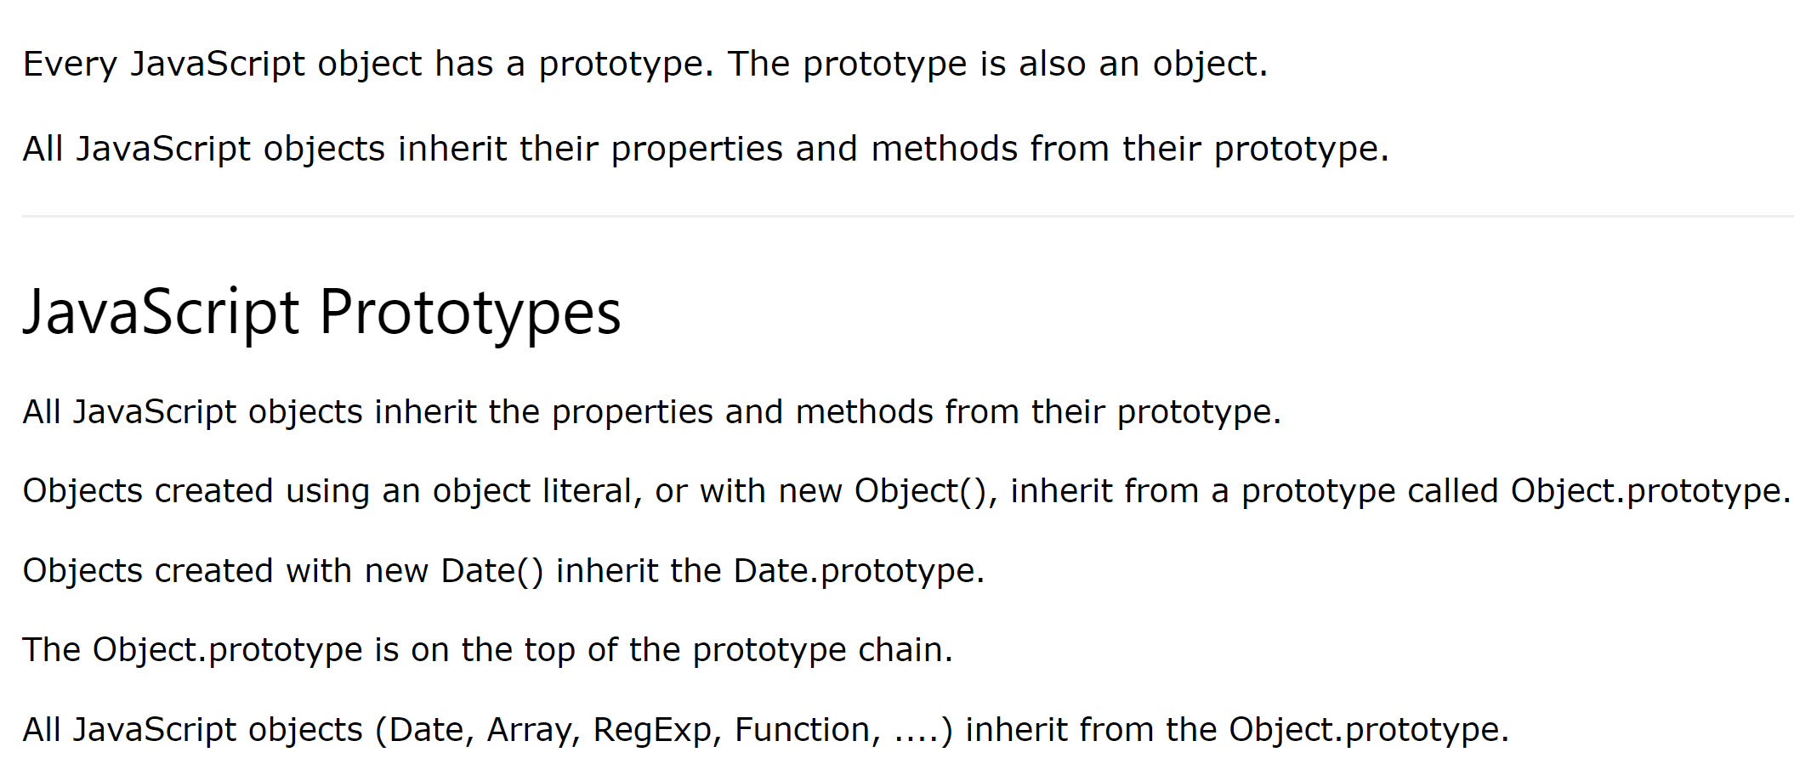
Java is class-based; JavaScript is prototype-based.
https://www.w3schools.com/js/js_object_prototypes.asp
All classes inherit from Object in Java
Run-time changes to the prototype change all the derived
objects
Super classes (like all other classes in
Java) can’t be changed at run-time
https://www.w3schools.com/js/js_object_prototypes.asp

Slide 13
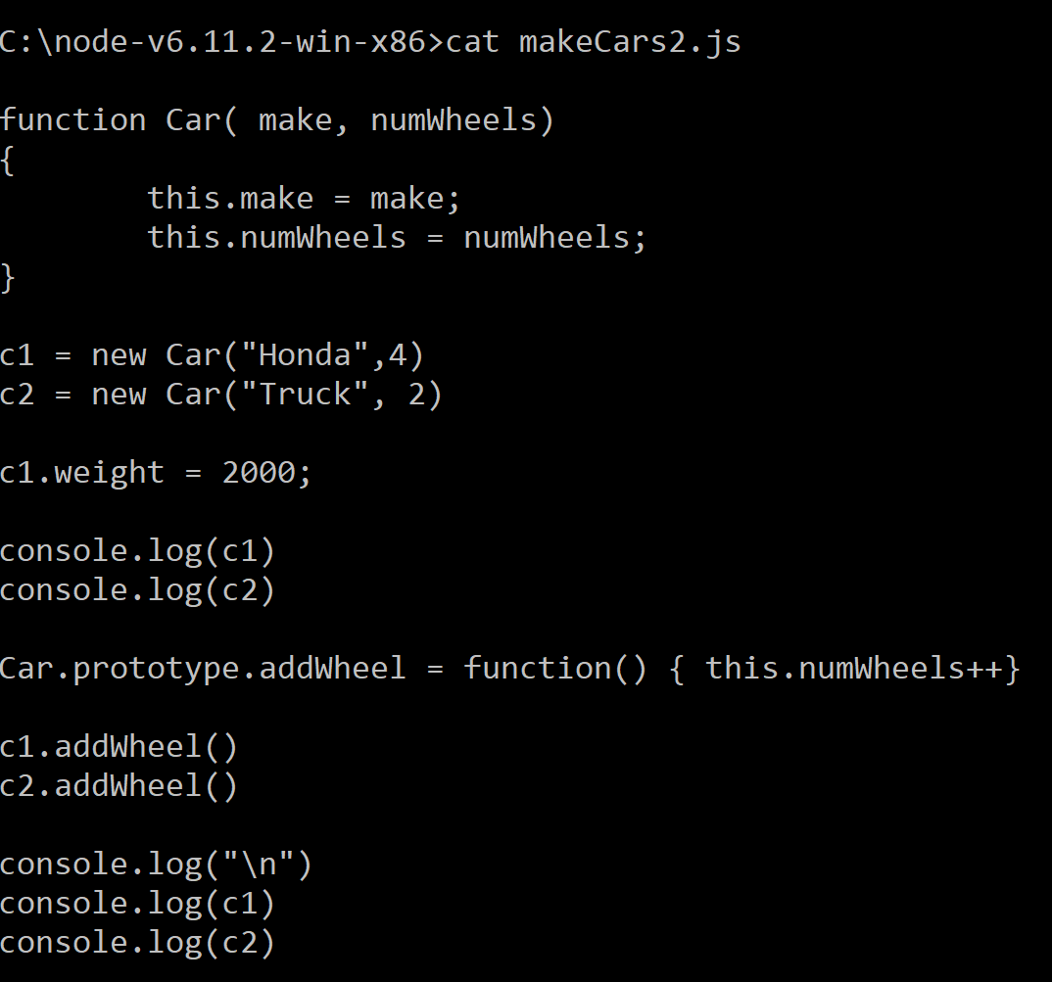
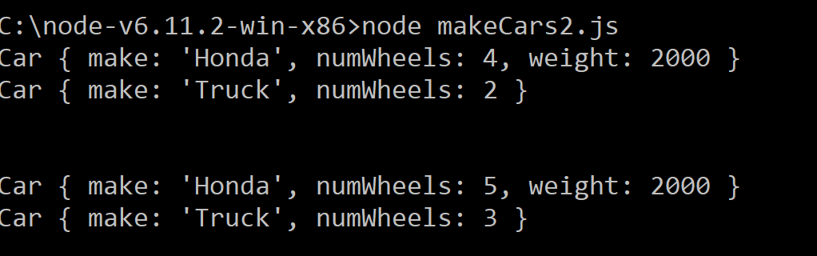
Run-time changes to the prototype change all the derived objects
There is no equivalent to this in Java….

Slide 14
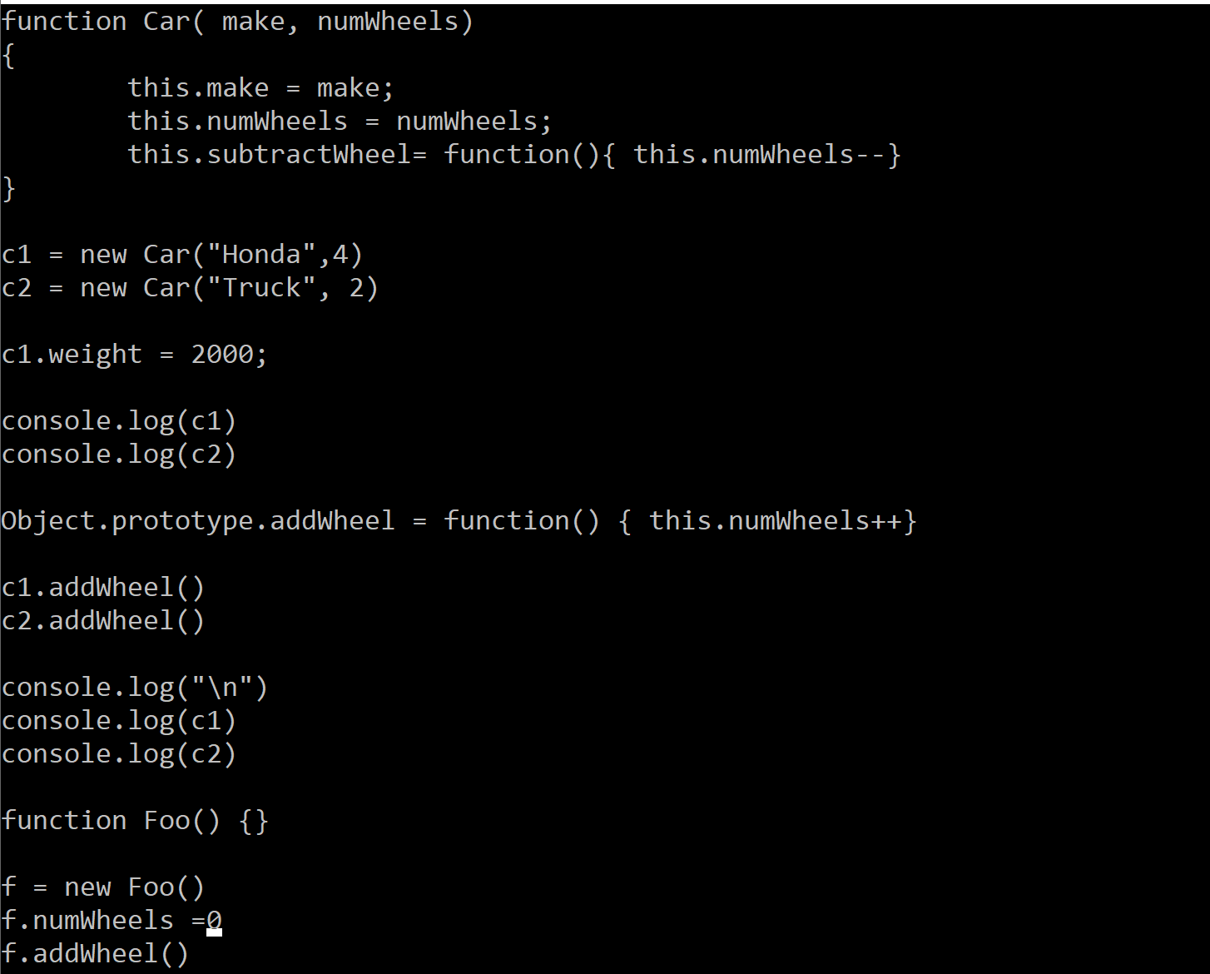
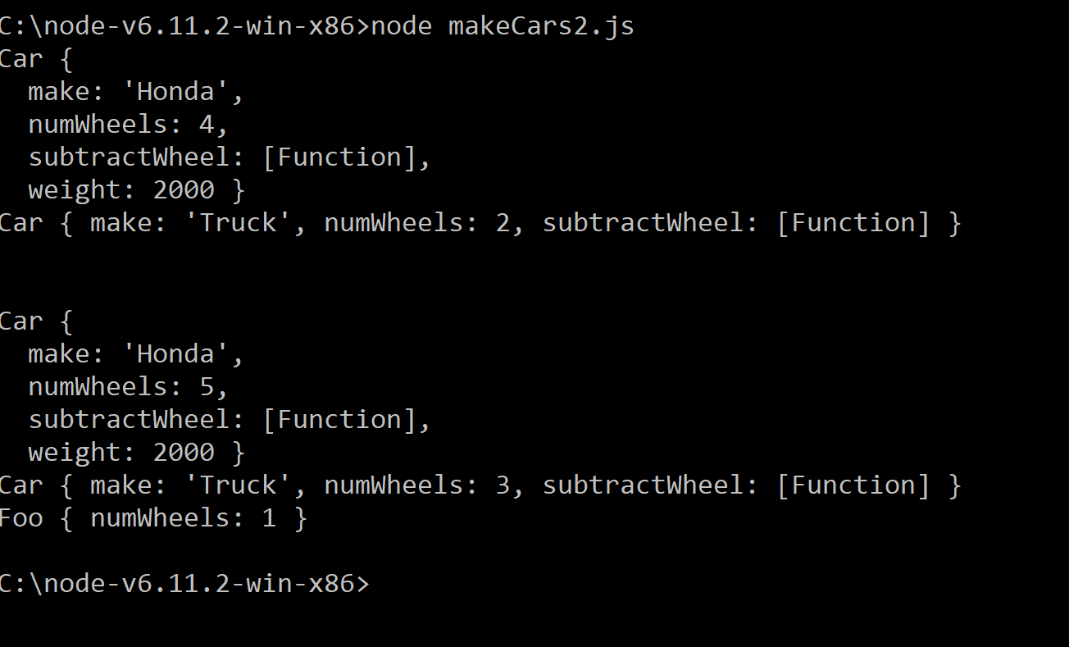
Changing the Object prototype, changes the behavior of all objects that have been and will be created in your javascript session
There is, to put it mildly, no equivalent in Java.
This maximizes flexibility but removes all
possibility of strong typing, which goes
against the Java design principle…

Slide 15
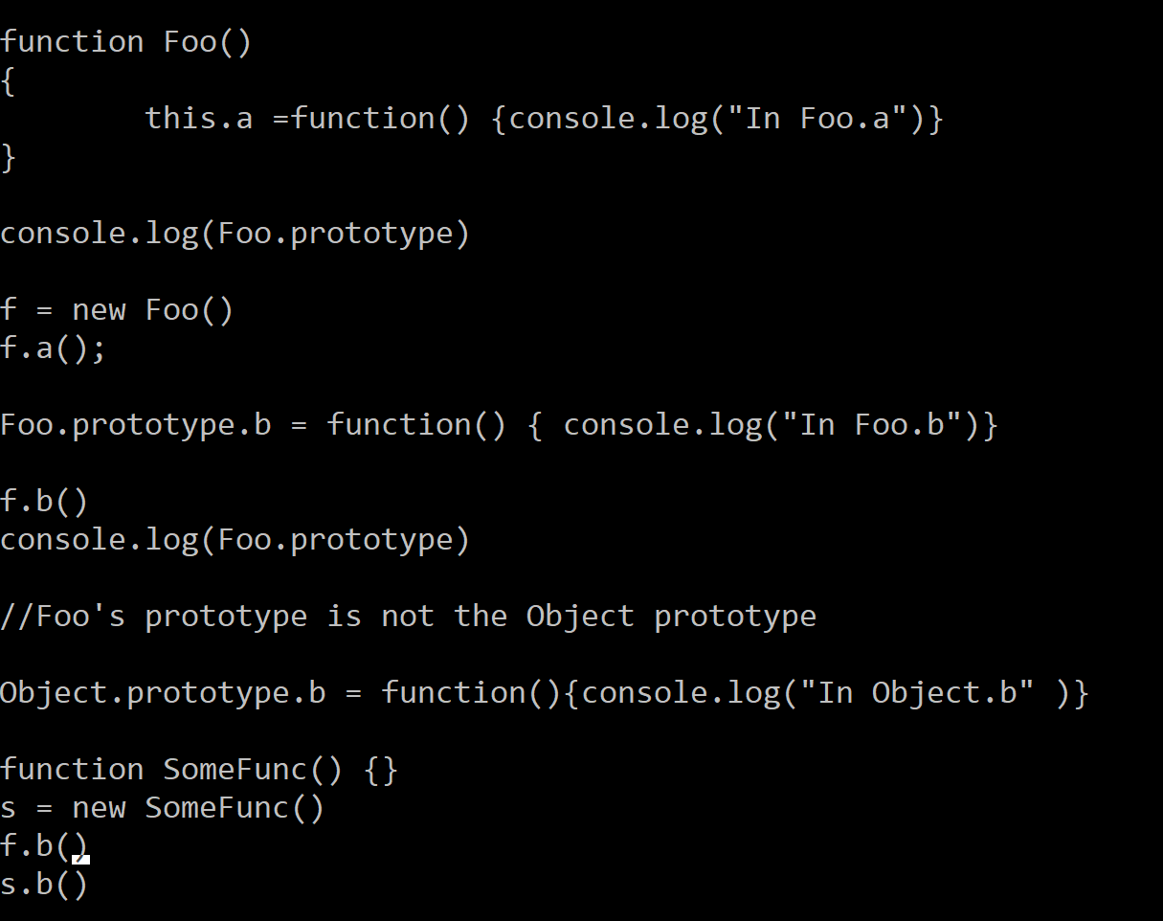
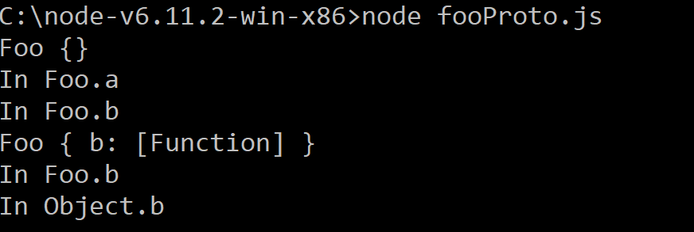
In Java, all classes extend Object. If you don’t specify a parent class, you directly inherit from Object
In Javascript, when you use “new”, you get a prototype associated with that constructor.
The prototype of the constructor prototype is the Object prototype (which is the top of the prototype chain)
Object.prototype
Foo.prototype
Object
Foo
Foo
Javascript new Foo()
Java new Foo()

Slide 16
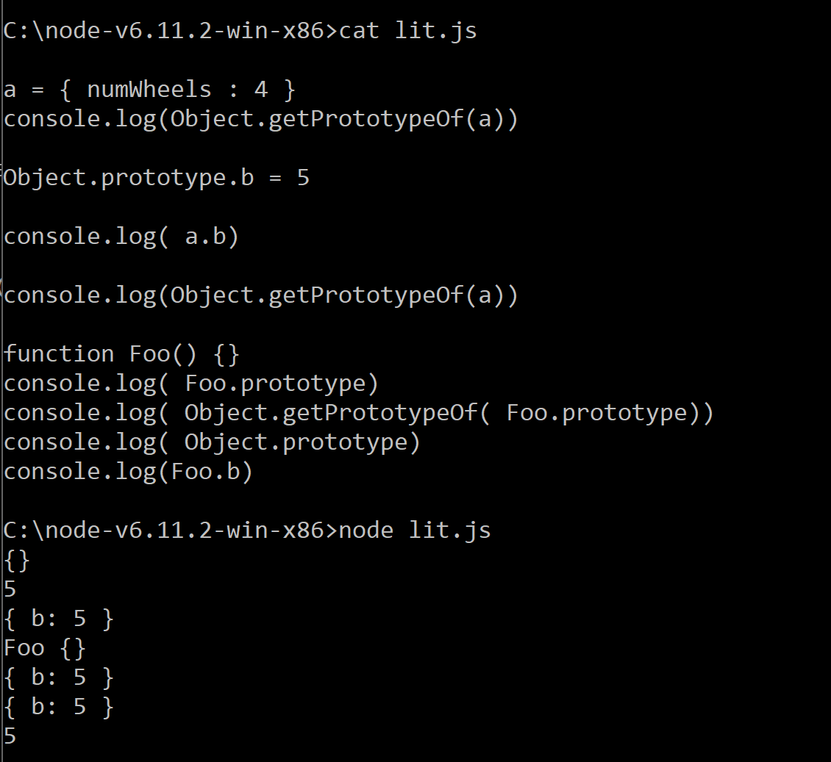
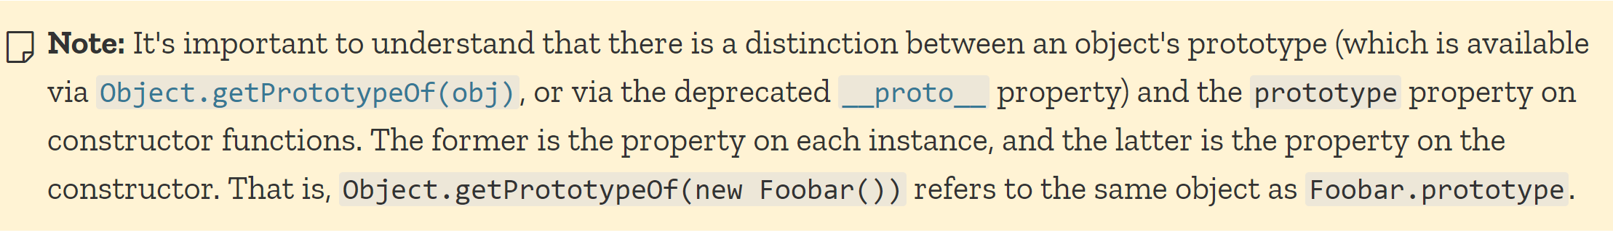
The prototype property only works on objects created via new…
Object.getPrototypeOf(obj) is more robust.
Objects created with literals have the Object prototype as the prototype.
Objects created with new have a Prototype associated with the
constructor of the function used to create them (accessed by
“.prototype”).
The differences between Object.getPrototype() and .prototype are confusing
and, I think, a weakness of the language
https://developer.mozilla.org/en-US/docs/Learn/JavaScript/Objects/Object_prototypes

Slide 17
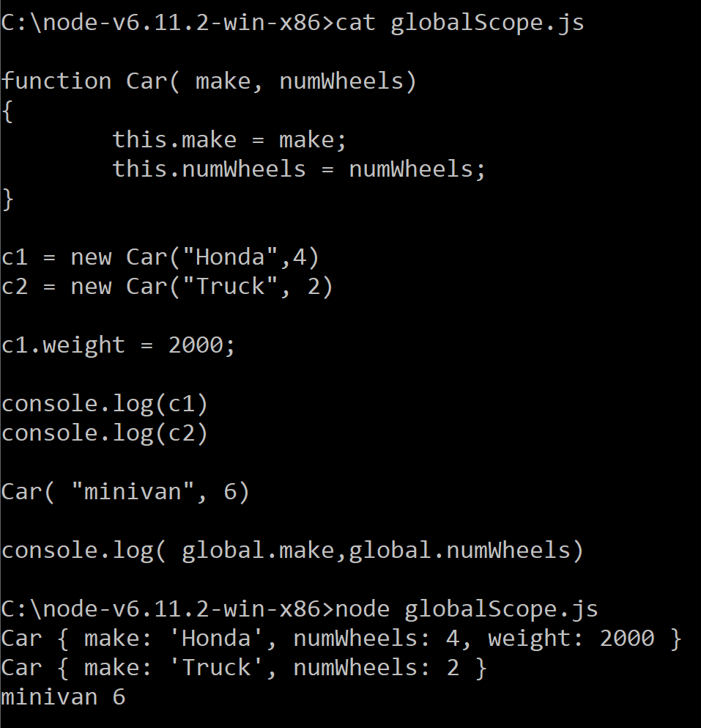
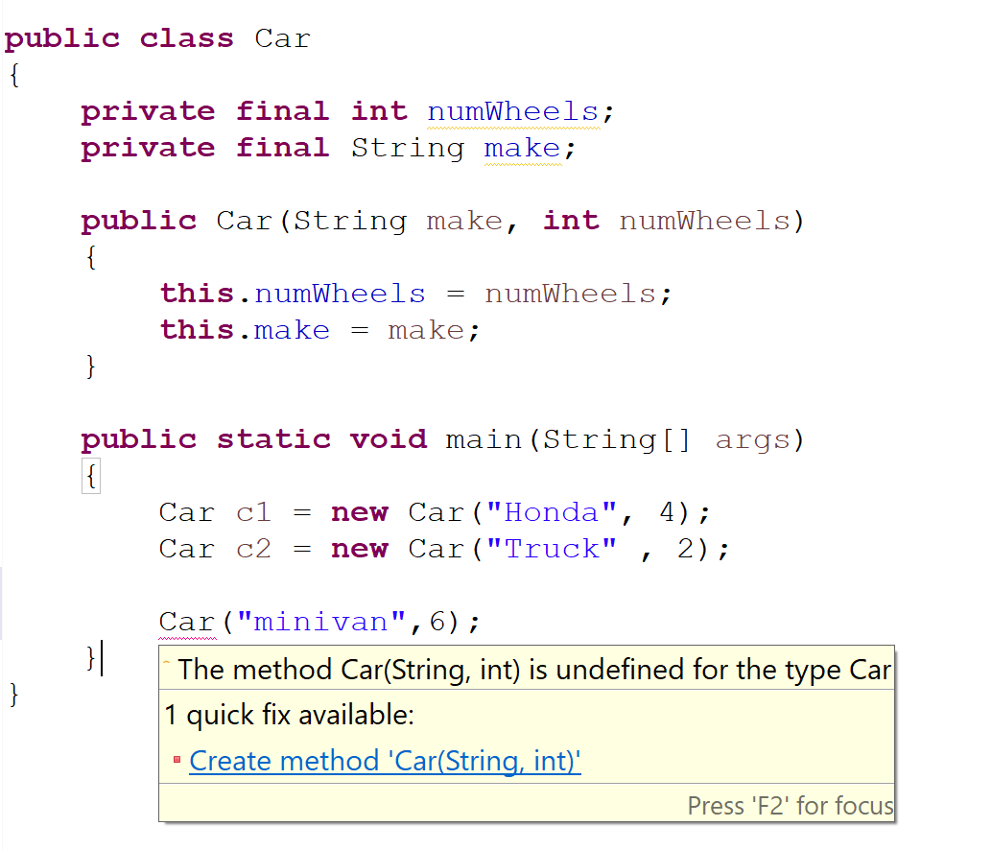
Java uses block-based scoping; JavaScript uses function-based scoping;
Since javascript constructors are just functions, they can be called without using new
There is no equivalent in Java;
There is no implicit “global” scope;
this is always attached to an instance of an object
The scope of “this” depends on the object on which
the function is invoked. The “global” object (in node.js)
Is invoked by default.

Slide 18
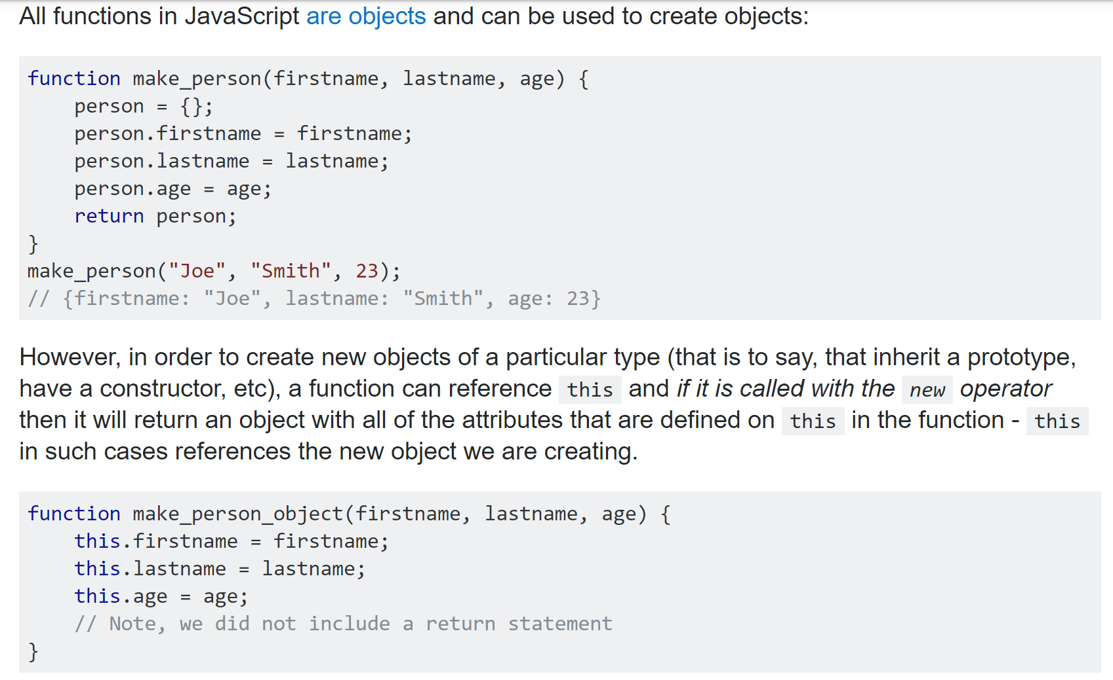
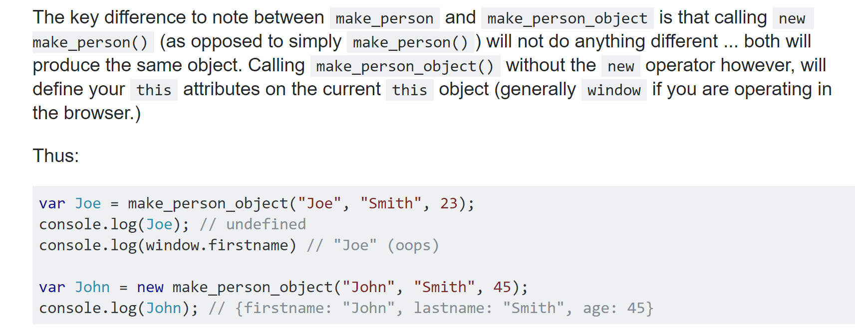
You can make your functions robust to whether they are invoked with “new”
In javascript in the browser,
what is called the “global” scope in node
has a different name (window)
https://stackoverflow.com/questions/5958417/javascript-function-and-object

Slide 19
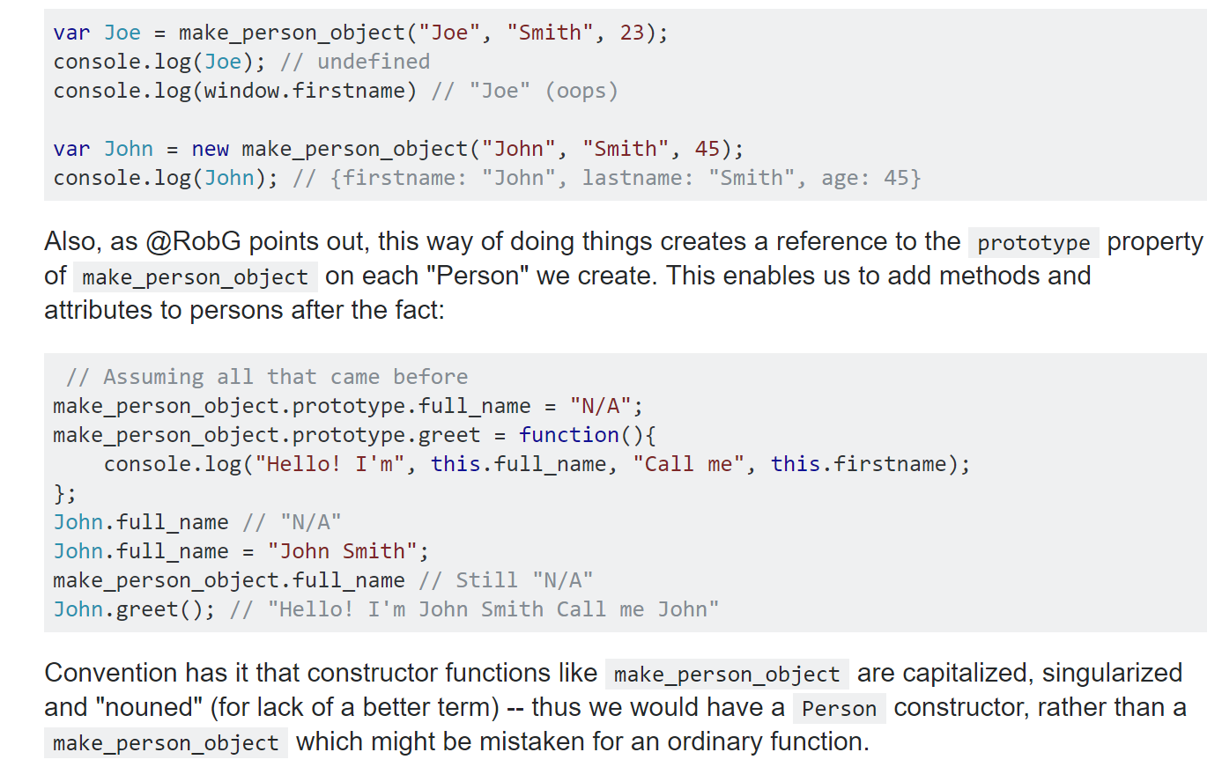
But prototypes will work differently depending on how you define your cosntructors….
https://stackoverflow.com/questions/5958417/javascript-function-and-object

Slide 20
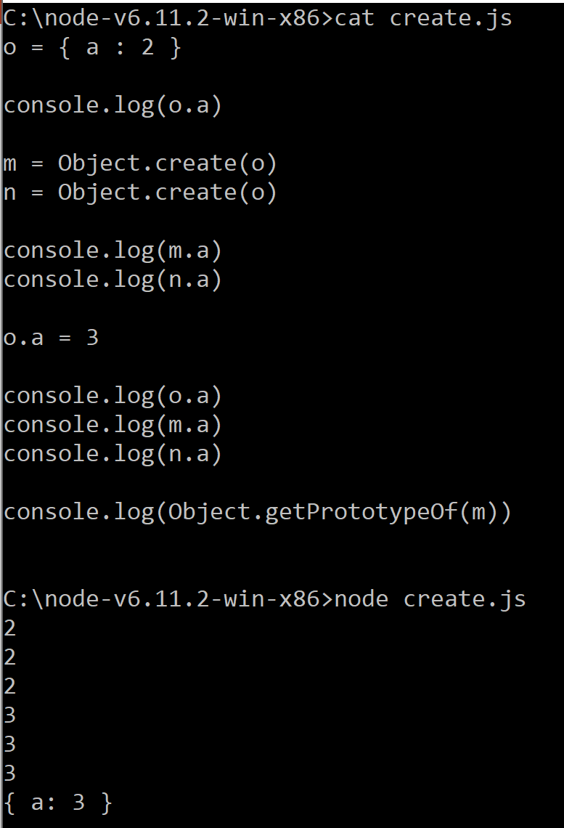
Any object in javascript can serve as a prototype
Here m and n have o as a prototype, so they all share one variable “a”.
(Sort of like a Java static…)
https://developer.mozilla.org/en-US/docs/Web/JavaScript/Inheritance_and_the_prototype_chain

Slide 21
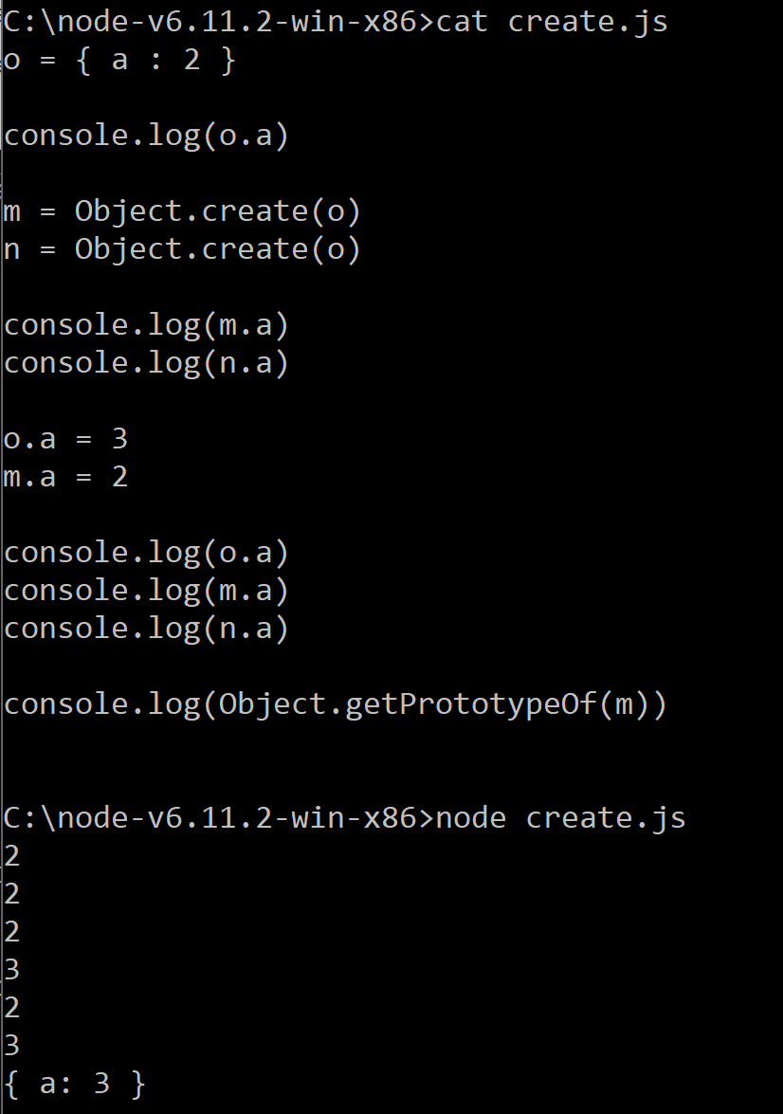
But here m has its own value of “a” which “masks” the
prototype value of a .
Javascript starts at the bottom of the prototype chain and
then works its way up…

Slide 22
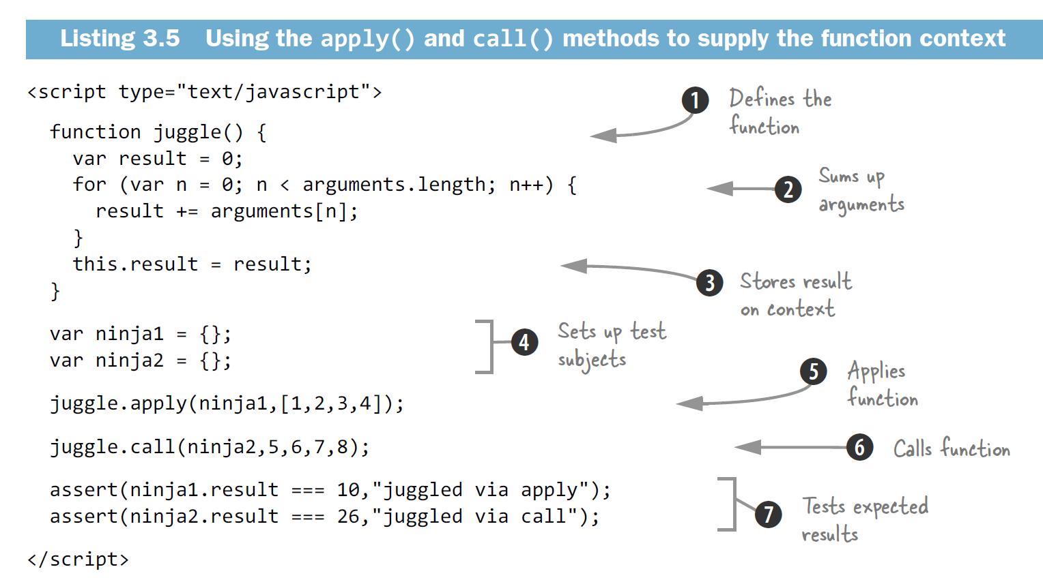
You can make “this” work on any object you want by using call and apply.
This can make Javascript very “R-like” in its syntax
Code example: “Secrets of the Javascript Ninjas”

Slide 23
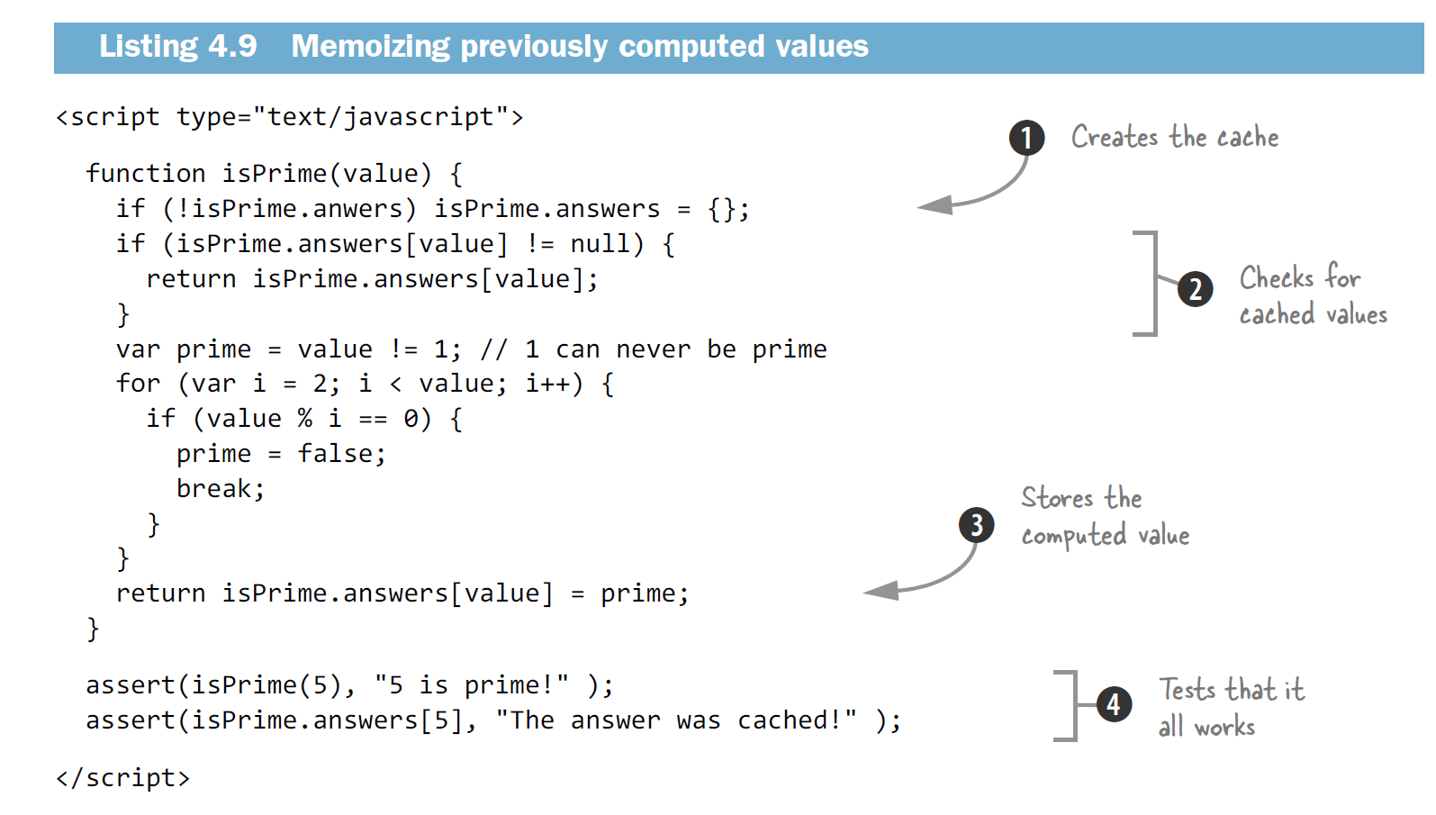
Javascript’s flexibility allows you to do so some cool things like building a cache entirely internal to a function
Here we build a cache directly into a prime number generator
Code example: “Secrets of the Javascript Ninjas”

Slide 24
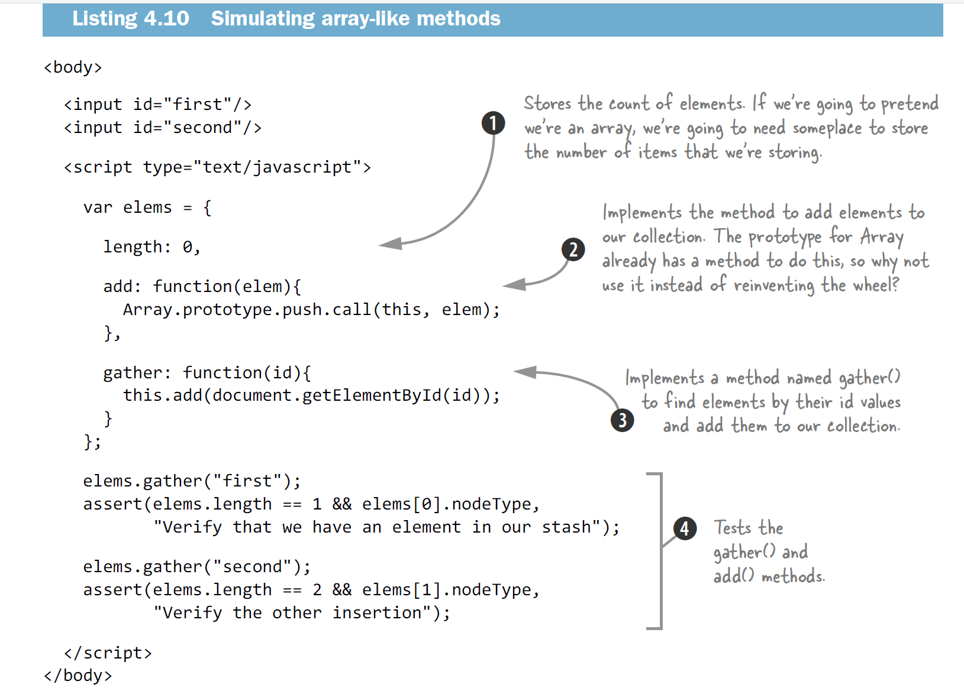
Java’s design emphasizes encapsulation. You are not allowed to reach into private methods and steal functionality.
Javascript’s design emphasizes flexibility. You can grab any piece of any function and apply it to any object you want.
In Java, we would use composition to wrap an Array and use the Array interface…
In Javascript, we can just apply the internal logic of Array to any arbitrary object.
Code example: “Secrets of the Javascript Ninjas”

Slide 25
Still to come:
Closures
Javascript has strange scoping rules.
Everything in javascript runs multi-threaded except your (single-threaded) code

Slide 26
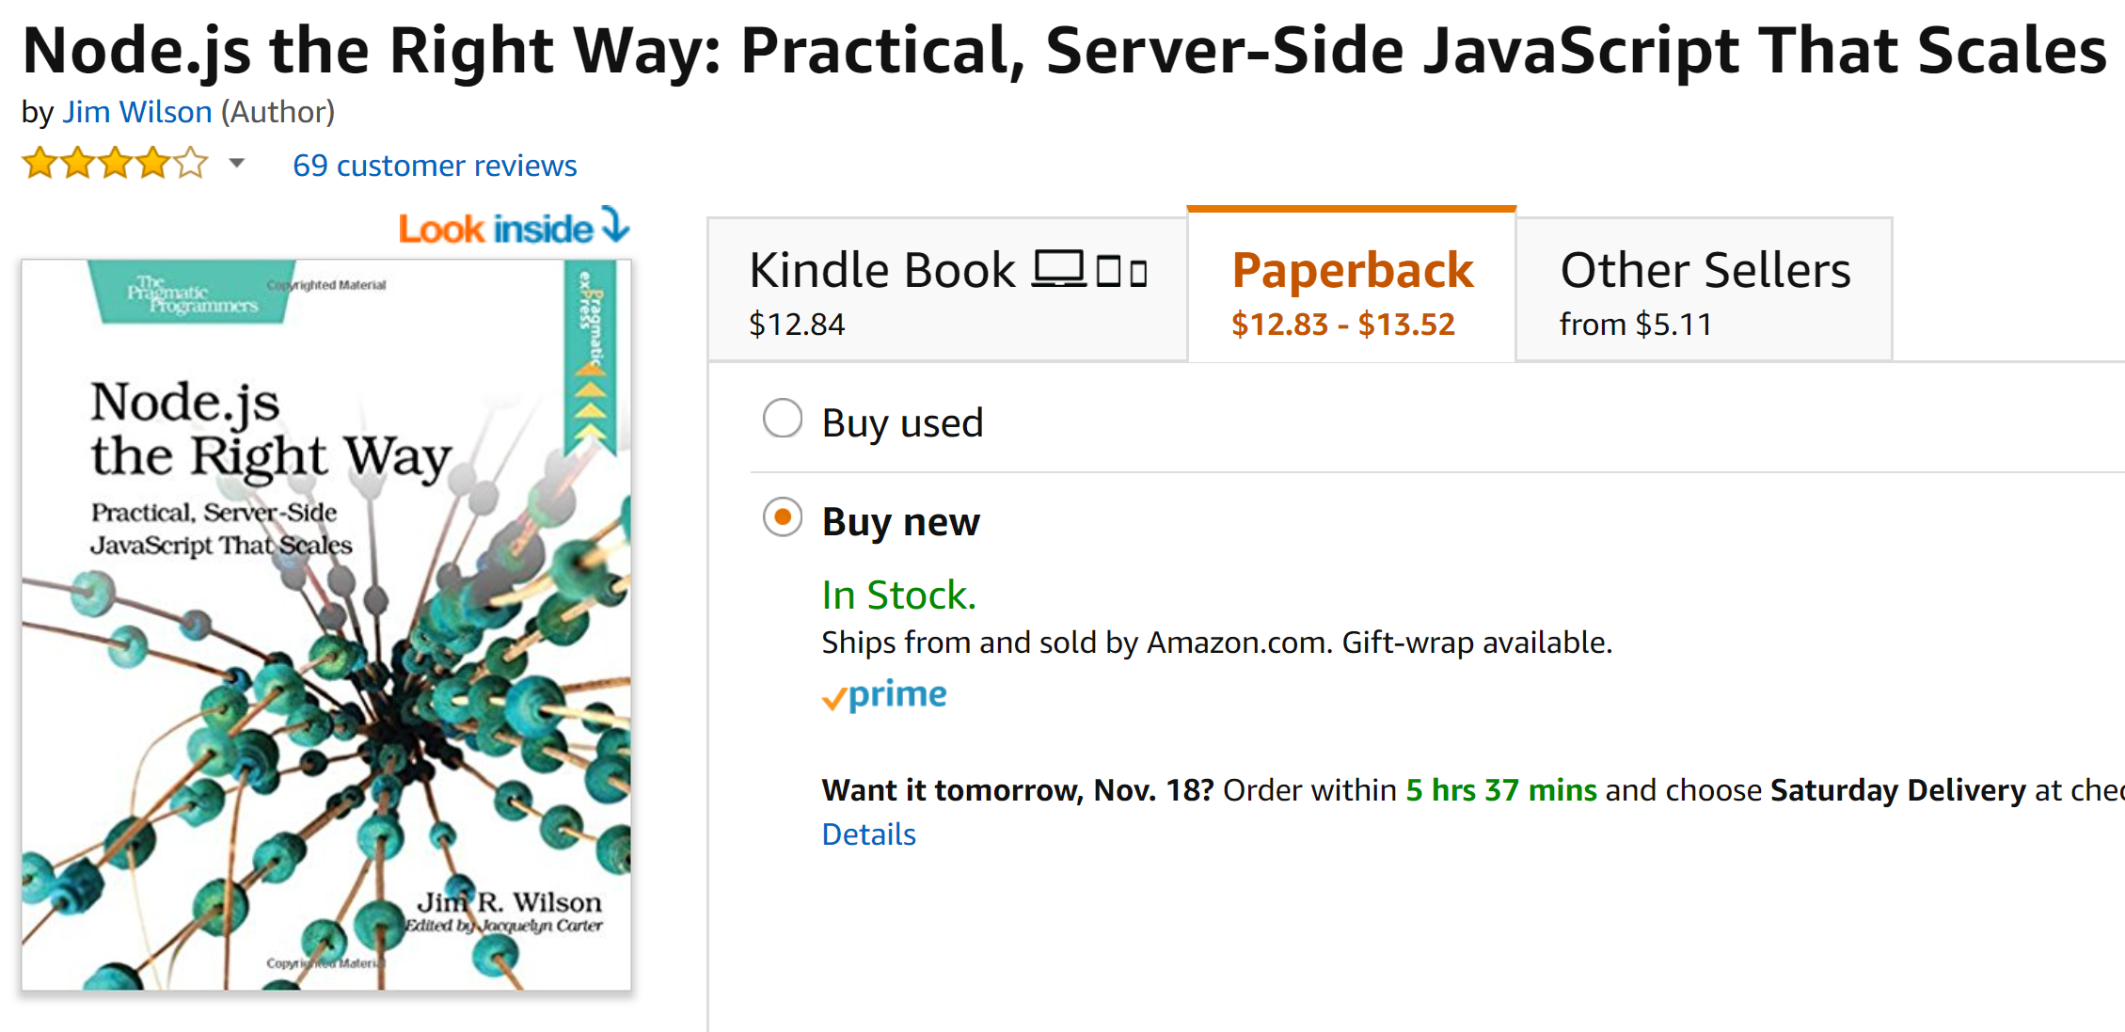

Slide 27


